Slide 1
Urgent. Related. Preventable.
Adverse childhood experiences (ACEs), overdose, and suicide are urgent, related, public health challenges that have consequences for us all.
These issues are preventable.

Slide 2
ACEs, overdose, and suicide are urgent public health challenges.

Slide 3
Understanding ACEs
Adverse Childhood Experiences (ACEs) are potentially traumatic events that occur in childhood.
ACEs can include experiencing violence, abuse, or neglect, witnessing violence in the home or community, or having a family member attempt or die by suicide.

Slide 4
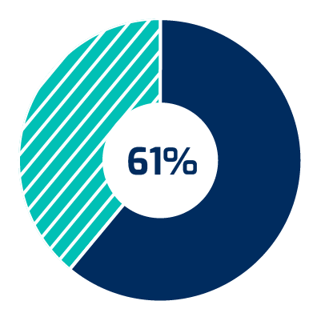
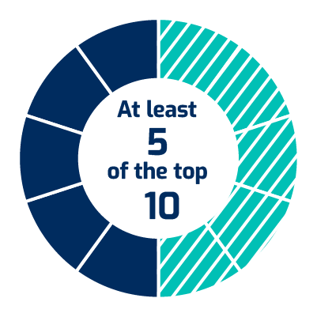
The Statistics of ACEs
61% of adults have experienced at least one ACE.
1 in 6 adults have experienced four or more types of ACEs.
At least 5 of the top 10 leading causes of death are associated with ACEs.

Slide 5
ACEs Impacts
ACEs can negatively impact development.
physical
emotional
mental
behavioral
ACEs can also have lasting effects on health, well-being, and prosperity far into adulthood.

Slide 6
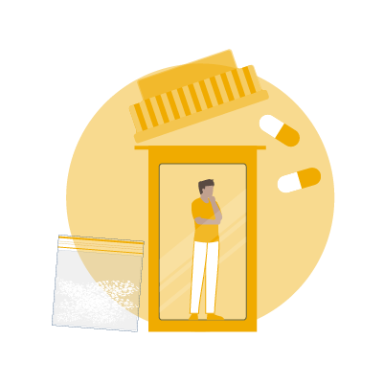
Understanding Overdose
Drug overdose is the poisoning that happens when a drug is taken in excessive amounts.
An overdose can be fatal or nonfatal, and all overdoses come with their own emotional and economic tolls.

Slide 7
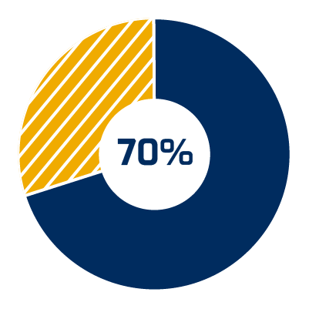
The Statistics of Overdose
Opioids were involved in
Nearly
In 2019
841,000
4 times
people died from drug overdoses from 1999 through 2019.
As many drug overdoses occurred than in 1999.
of overdose deaths in 2019.

Slide 8
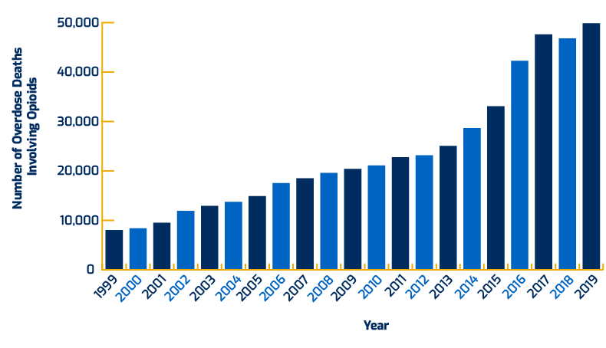
Overdose Over Time
Overdose deaths involving opioids, including prescription opioids, heroin, and synthetic opioids (like fentanyl), have increased over six times since 1999.
Source: National Center for Health Statistics, National Vital Statistics System, Mortality

Slide 9
Understanding Suicide
Dying by suicide continues to be a leading cause of death in the United States.
Suicidal ideation and attempts are also on the rise.

Slide 10
The Statistics of Suicide
In 2019
Suicide was the
2nd Leading
12,000,000
cause of death among individuals between the ages of 10 and 34, and the
adults aged 18 or older reported having serious thoughts of suicide.
4th Leading
1,400,000
cause of death among individuals between 35 and 44.
adults attempted suicide.
Source: CDC

Slide 11
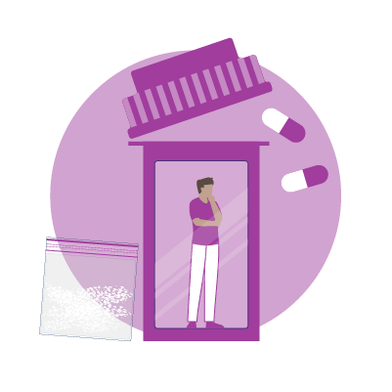
Exposure to Suicide
Exposure to…
Another person’s suicide
Substance use disorder
A family history of suicide
Suicidal ideation
are risk factors that increase the possibility of suicide.

Slide 12
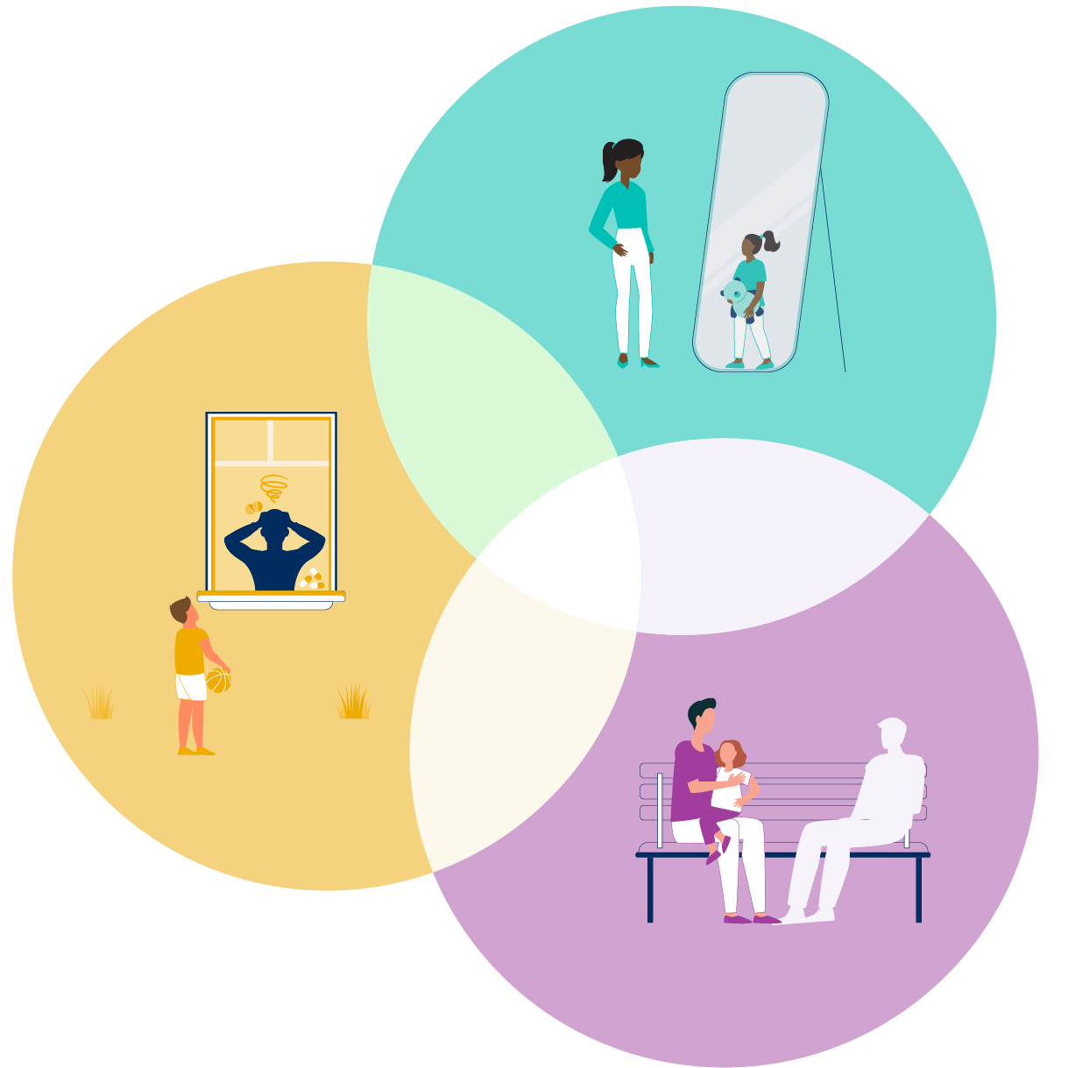
ACEs, overdose, and suicide are related public health challenges.

Slide 13
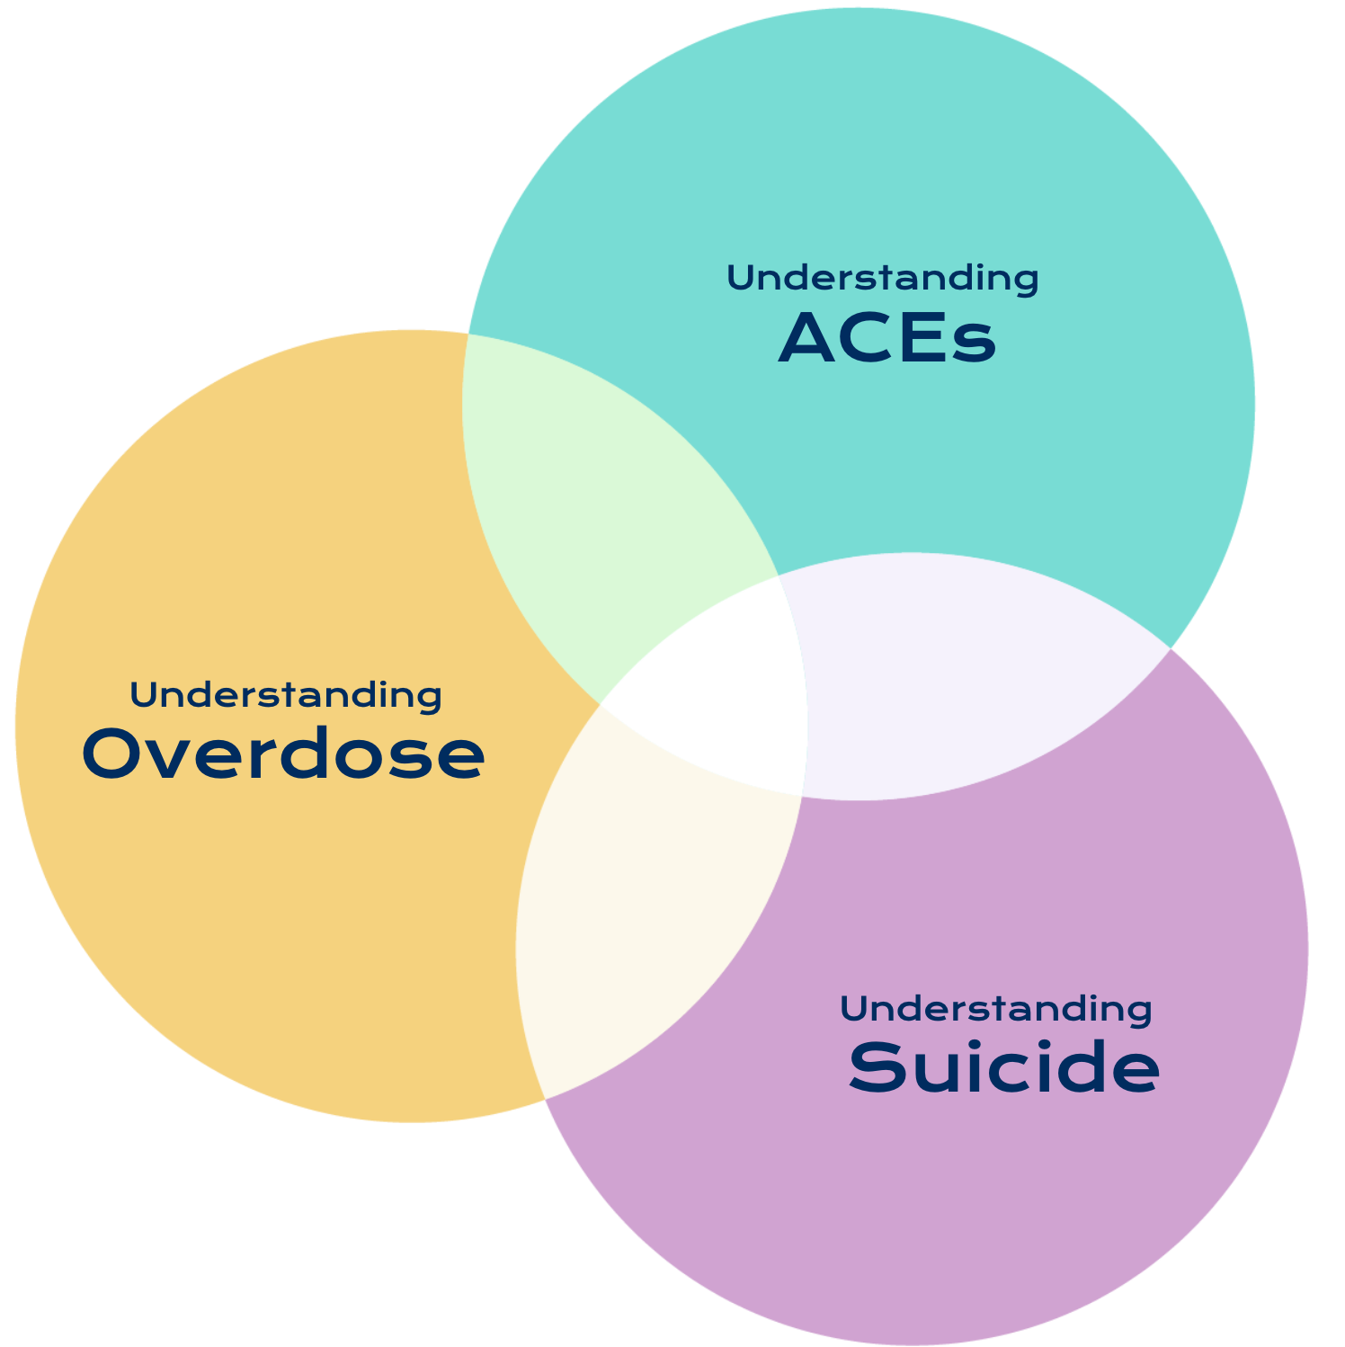
Related Issues
ACEs, suicide, and overdose are related issues.
Exposure to ACEs increases the risk of overdose and suicide later in life.

Slide 14
ACEs and Overdose
ACEs are associated with increased risk of overdose and suicide later in life and are associated with younger opioid initiation, injection drug use, and lifetime overdose.
Source: Stein MD, Conti MT, Kenney S, et al. Adverse childhood experience effects on opioid use initiation, injection drug use, and overdose among persons with opioid use disorder. Drug Alcohol Depend. 2017;179:325-329. doi:10.1016/j.drugalcdep.2017.07.007
Notes:
Source: Stein MD, Conti MT, Kenney S, et al. Adverse childhood experience effects on opioid use initiation, injection drug use, and overdose among persons with opioid use disorder. Drug Alcohol Depend. 2017;179:325-329. doi:10.1016/j.drugalcdep.2017.07.007

Slide 15
Overdose and Suicide
Opioid Use Disorder (OUD) involving prescription drugs is associated with an increase of 40 to 60% in the risk of suicidal ideation.
Source: https://pubmed.ncbi.nlm.nih.gov/28364579/
Notes:
Source: https://pubmed.ncbi.nlm.nih.gov/28364579/

Slide 16
ACEs and Suicide
Experiencing any ACE is associated with an increased risk for suicide; the odds of ever attempting suicide are 30 times higher for adults with four or more ACEs compared to adults with no ACEs.
Source: Hughes K, Bellis MA, Hardcastle KA, Sethi D, Butchart A, Mikton C, Jones L., Dunne MP. The effect of multiple adverse childhood experiences on health: a systematic review and meta-analysis. The Lancet; 2017;2:e356-66.
Notes:
Source: Hughes K, Bellis MA, Hardcastle KA, Sethi D, Butchart A, Mikton C, Jones L., Dunne MP. The effect of multiple adverse childhood experiences on health: a systematic review and meta-analysis. The Lancet; 2017;2:e356-66.

Slide 17
ACEs, Overdose, and Suicide
ACEs are associated with increased risk of overdose and suicide later in life. For children, losing a loved one to suicide or overdose is an ACE. Experiencing these is associated with increased risk of future overdose or suicide.

Slide 18
ACEs, overdose, and suicide are preventable public health challenges.

Slide 19
Prevention Strategies
Some strategies focus on prevention through system-level changes, public education, and implementation of policies and programs based on the best available evidence.
Together, we can shrink the impact of these three interrelated issues.

Slide 20
Using Collaborative Strategies
Successful approaches often require collaboration with other sectors to address these complex and related challenges appropriately.
Greater impact happens when there is alignment between policy, funding, and programs that addresses these three issues together, rather than some current efforts which focus on each issue individually.
Example Strategy
By creating policies based on the understanding that childhood trauma is a risk factor for suicide and overdose, we can protect children today and prevent future risks.

Slide 21
Addressing today’s crises and preventing tomorrow’s
Some strategies focus on prevention through system-level changes, public education, and implementation of policies and programs based on the best available evidence.
We need a coordinated approach to address the interrelated crises of exposure to ACEs, overdose, and suicide to:
Increase understanding and coordination across these treatment and prevention fields.
Engage a broad movement of champions and change agents in communities.
Ensure equity in policies, programs, and services while reducing disparities.
Invest in research and evaluation to better understand what works when combating these challenges, why those approaches work, and for whom they work.
Implement successful treatment and prevention strategies and adapt them for specific cultural contexts.

Slide 22
What Now?
You have the power to make a difference.
Find the Words: To Educate others about the intersection of these urgent public health issues.
Spread the Word: To Generate awareness of these interrelated public health issues.
Visit UrgentRelatedPreventable.org to learn more

